Slide 1



Income Predictor
Alberto Torres

Slide 2
Decisions
Crossroad about going to college.
Is the income after college worth it?
Predicting model to forecast annual income for individuals with a college education.

Slide 3
A tool For Educational Institutions
With the predictive model, institutions can show students or potential students that in the long term a college education is the best route.
The model will try to predict if the individual has the potential to make more than 50 thousand a year.
Shows individuals a forecast of the future.

Slide 4


College Enrollment Rate downfall
Nearly one million less students enrolled in college in 2022 then before 2020.
From 2019-2021 colleges seen undergraduate student enrollment fall by 6.6%.
Biggest decline in more than 50 years.
Americans choose jobs over college : NPR

Slide 5
Short-term benefits vs. long-term benefits of a degree.
According to Georgetown University, bachelor's degree holders were found to "earn a median of $2.8 million during their career, 75% more than if they had only a high school diploma."
Many high school students go for short-term money rather than a long-term career and high wages.

Slide 6
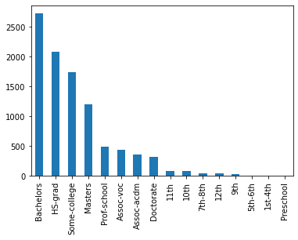
Data understanding
Individuals who make more than 50K a year
Machine learning model:
Demonstrates who is making more money annually.
Predictor takes in attributes such as education, relationship, hours worked, etc.
In Dataset 9.6K/39.4K individuals made over 50K
Num of individuals

Slide 7
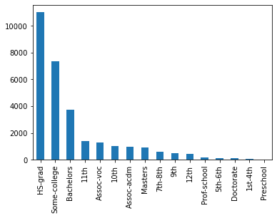
Data understanding Cont.
Individuals who make less than 50K a year
Georgetown University study, HS-Grads are the ones earning less than 50K a year.
There’s more than 50% HS-grads that make less than 50K then someone that has their bachelor's degree.
Num of individuals

Slide 8
Predictive model
Model
Random Forest- is learning method for classification, regression and other tasks that operates by constructing a multitude of decision trees at training time.
Accuracy on dataset: individual’s who make <50K: 82%
Accuracy on dataset: individual’s who make >50K: 64%
Variables
Target Variable: Income >50K
Education: Highest level of education individual achieved
Occupation: Current work position
Race
Gender: Male or Female
Relationship: If individual is a husband, wife, single, etc.
Hours worked per week

Slide 9
Next Steps
Bigger dataset
Handle imbalanced dataset

Slide 10

Thank you

